Slide 2
2022 is a year of the Water Tiger.
It starts on February 1st, 2022 which is the Chinese Lunar New Year and ends on January 21st,2023
A Water Tiger year occurs every 60 years.

Slide 3
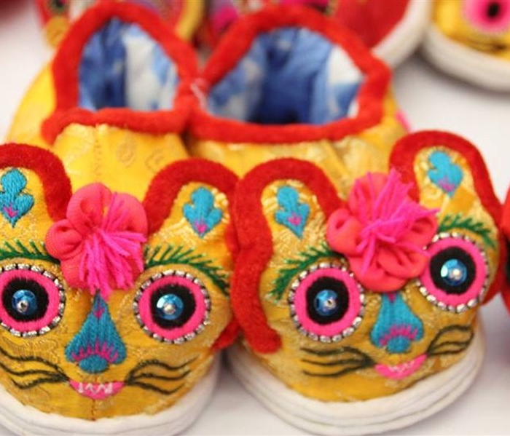
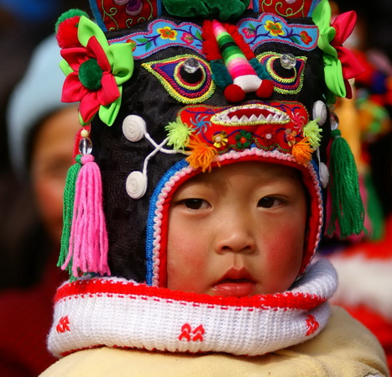
What does the Tiger symbolize?
The Tiger is known as the king of all beasts in China.
The zodiac sign Tiger is a symbol of strength and courage. Many Chinese kids wear hats or shoes with a tiger image for good luck.

Slide 5
What are Tiger personality traits?
People born in a year of the water Tiger have a strong sense of self-esteem and learning ability.
People born in a year of the Tiger in general are brave, competitive, unpredictable, and confident. They are very charming and well-liked by others. But sometimes they are likely to be impetuous, irritable, and overindulgent.
With stubborn personalities and tough judgment, Tigers work actively and express themselves boldly.
With great confidence and indomitable fortitude, they can be competent leaders. They will not make preparations for anything, but can handle anything that comes along.

Slide 6
The 12 Zodiac signs – a cycle of 12 years

Slide 7
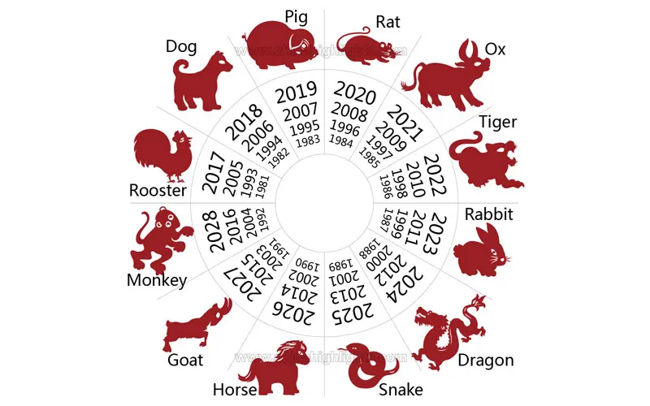
Ox and Goat are the luckiest zodiac signs in the year of 2022.
Rat, Snake, Monkey, Pig and Dog, will need to make more effort in order to make achievements.
Rabbit, Dragon, Horse, and Rooster are destined to enjoy a smooth life and good luck in making money this year.

